Slide 1
Learning to rank with BPR-MF
Massimo Quadrana
18th December 2016

Slide 2
BPR
BPR: Bayesian Pairwise Ranking (Rendle et al, 2009)
KNN and MF are trained for rating prediction but evaluation is on item prediction
Goal: Optimize directly for ranking
Infer ranking from implicit behavior
Only positive observations are available
Non-observed is a mixture of real negative feedback and missing values

Slide 3
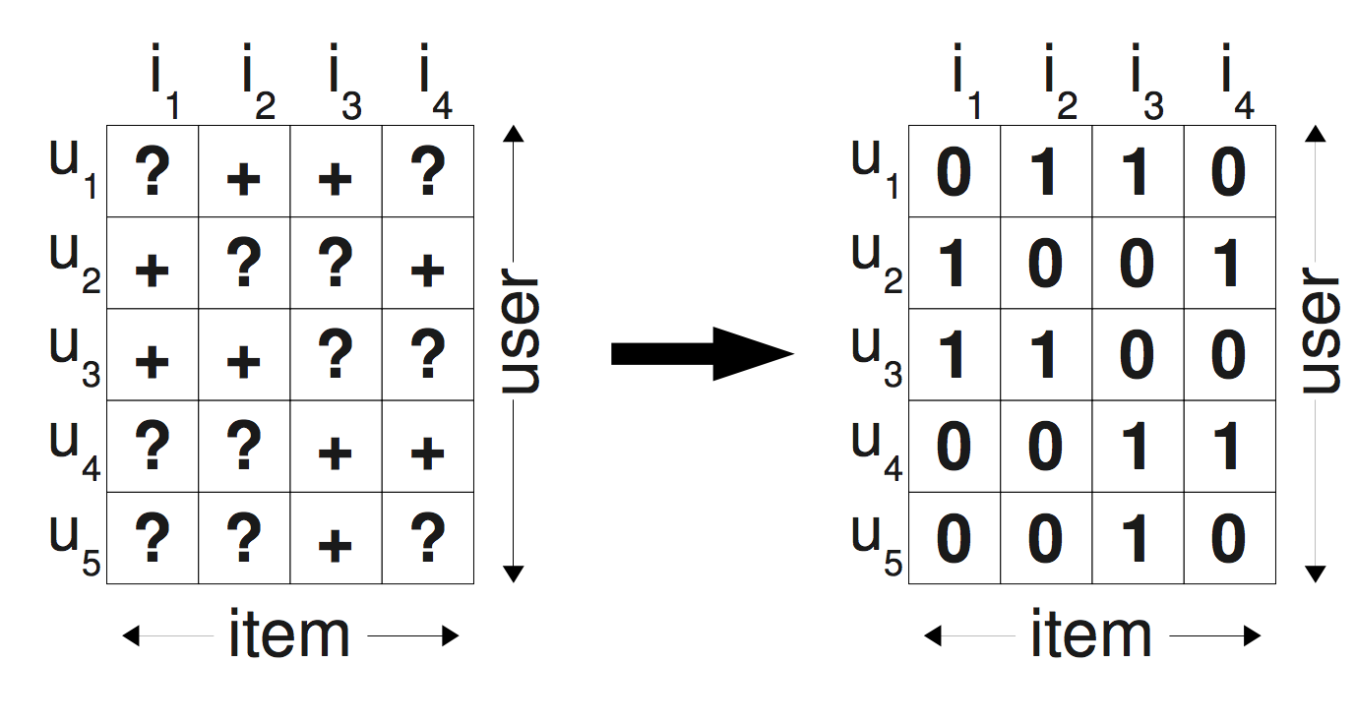
Handling negative feedback
Fill with zeros (standard approach)

Slide 4
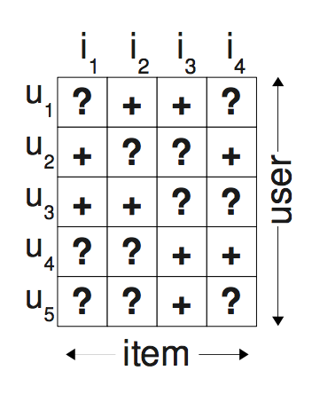
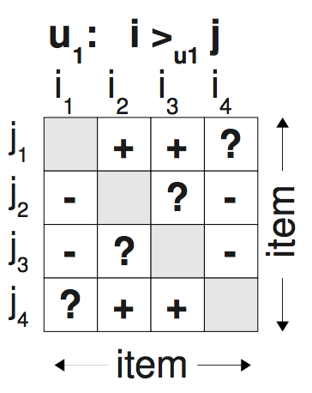

Handling negative feedback
Pairwise preferences

Slide 5
BPR-OPT
Loss function
Maximize the log-likelihood of the training data given the parameters (Maximum A Posteriori, see paper)
Or equivalently minimize the Negative LL
Equivalent to optimizing for ROC-AUC (see paper)
Where:
probability that user i prefers item j over item k

Slide 6
Logistic sigmoid function
Continuous approximation of the indicator (step) function
Interesting facts
Not the only possible approximation of the step function (tanh, erf, …)
Used as activation function in Neural Networks

Slide 7
LEARN-BPR
Repeat
draw (i,j,k) from Ds
Until convergence
Stochastic Gradient
Ascent updates

Slide 8
Item sampling
“Bootstrap” training from Ds
Uniform user – uniform item
Sample a user i uniformly at random
Sample a positive item pair (i,j) uniformly at random
Sample a negative item pair (i,k) uniformly at random
Try with and without replacement
Variants:
Sample positive items by popularity
Advanced sampling methods
Improving Pairwise Learning for Item Recommendation from Implicit Feedback, Rendle et al, 2014
Bayesian Personalized Ranking with Multi-Channel User Feedback, Loni et al, 2016

Slide 9
Item sampling
“Bootstrap” training from Ds
Uniform user – uniform item
Sample a user i uniformly at random
Sample a positive item pair (i,j) uniformly at random
Sample a negative item pair (i,k) uniformly at random
With or without replacement
Variants:
Sample positive items by popularity
Advanced sampling methods
Improving Pairwise Learning for Item Recommendation from Implicit Feedback, Rendle et al, 2014
Bayesian Personalized Ranking with Multi-Channel User Feedback, Loni et al, 2016

Slide 10

BPR and MF
Set
Use MF to compute
X user factors
Y item factors
Optimize with LEARN-BPR
Positive
sample
Negative
sample
Y^{T}
R
$$≈$$
X

Slide 11
SGA Updates
Partial derivatives
Let’s code it!

Slide 12
Comparing what we have seen in this practices
Movielens 100k
Converted to implicit (threshold >=4)
80/20 holdout split
Hyper-parameters optimized with Grid Search + cross validation
Metric: ROC-AUC
Not really thorough optimization tough
Scripts in: algo_comparison/grid_search.py

Slide 13
Algo | ROC-AUC | Precision | Recall | MAP | MRR | NDCG
Top-pop | 0,8580 | 0,1184 | 0,1122 | 0,0765 | 0,3184 | 0,1179
GlobalEffects | 0,6648 | 0,0101 | 0,0120 | 0,0026 | 0,0159 | 0,0077
ItemKNN | 0,9181 | 0,2131 | 0,2241 | 0,1664 | 0,4759 | 0,2233
SLIM | 0,9194 | 0,2170 | 0,2306 | 0,1774 | 0,5168 | 0,2376
FunkSVD | 0,8494 | 0,0351 | 0,0507 | 0,0175 | 0,0758 | 0,0377
iALS | 0,9179 | 0,1787 | 0,2115 | 0,1259 | 0,3857 | 0,1953
BPRMF | 0,8524 | 0,1492 | 0,1673 | 0,1074 | 0,3668 | 0,1619

Slide 14
Algo | ROC-AUC | Precision | Recall | MAP | MRR | NDCG
Top-pop | 0,8580 | 0,1184 | 0,1122 | 0,0765 | 0,3184 | 0,1179
GlobalEffects | 0,6648 | 0,0101 | 0,0120 | 0,0026 | 0,0159 | 0,0077
ItemKNN | 0,9181 | 0,2131 | 0,2241 | 0,1664 | 0,4759 | 0,2233
SLIM | 0,9194 | 0,2170 | 0,2306 | 0,1774 | 0,5168 | 0,2376
FunkSVD | 0,8494 | 0,0351 | 0,0507 | 0,0175 | 0,0758 | 0,0377
iALS | 0,9179 | 0,1787 | 0,2115 | 0,1259 | 0,3857 | 0,1953
BPRMF | 0,8524 | 0,1492 | 0,1673 | 0,1074 | 0,3668 | 0,1619

Slide 15
Algo | ROC-AUC | Precision | Recall | MAP | MRR | NDCG
Top-pop | 0,8580 | 0,1184 | 0,1122 | 0,0765 | 0,3184 | 0,1179
GlobalEffects | 0,6648 | 0,0101 | 0,0120 | 0,0026 | 0,0159 | 0,0077
ItemKNN | 0,9181 | 0,2131 | 0,2241 | 0,1664 | 0,4759 | 0,2233
SLIM | 0,9194 | 0,2170 | 0,2306 | 0,1774 | 0,5168 | 0,2376
FunkSVD | 0,8494 | 0,0351 | 0,0507 | 0,0175 | 0,0758 | 0,0377
iALS | 0,9179 | 0,1787 | 0,2115 | 0,1259 | 0,3857 | 0,1953
BPRMF | 0,8524 | 0,1492 | 0,1673 | 0,1074 | 0,3668 | 0,1619

Slide 16
Take-home messages
SLIM is the best but…
Movielens100k is one single (small) dataset → experiment with more/larger datasets
Most of the real data is implicit (explicit feedback is costly)
Never, never, never use RMSE
Always evaluate over multiple ranking metrics
Use a ranking loss function
Still, Implicit ALS works well (widely used in practice)
Combine/Stack your models (e.g. KNN + MF/SLIM)
Tuning
Carefully choose the metric to optimize
Grid Search is expensive, try Random Search

Slide 17
Thank you!

